Slide 1


Savitribai Phule Pune University, Pune Amrutvahini College Of Engineering, Sangamner Department of E&TC Engineering A Presentation on
“Voice operated lift control system with safety”
Presented By
1. Bhoknal Gayatri Satish (B190103011) 2. Varpe Aditya Rajendra (B190103069) 3. Waman Onkar Uttam (B190103073) 4. Zanjare Shaileshkumar Gangaram (B190103076)
Under the Guidance of
Prof. V. R. Aware

Slide 2
Contents
Introduction
Need of project
Research motivation
Aim and objective of project
Literature Survey
Problem Statement
Block Diagram of Project
Block diagram description
Circuit Diagram
Prototype images
Hardware & Software requirements
Description of Components
Flow chart
Detailed algorithm
Results
Advantages
Limitation
Application
Conclusion
Future Scope
References

Slide 3
Introduction
Physically challenged people face many problems every day. One of these challenges is the use of elevators in many buildings. They should be able to enjoy using the elevator easily.
To overcome this challenge for the them, we must focus on the following issues: Make sure the person is at the elevator door, get elevator there and ask person where to go and accordingly go to respective floor.
Speech is the superior personality of the human beings gifted by the nature. Speech helps to deliver the thoughts and messages between human. Speech recognition is the process of the computer recognizing human speech to generate a string of words or commands. Sometimes it is known as automatic speech recognition.
Speech recognition is becoming more perplexing and difficult task. The speech recognition research is focuses mainly on large vocabulary, continuous speech capabilities and speaker independence[3].
A voice-operated elevator system is proposed where the user’s input commands to control the movement of the elevator system are kept convenient for the users. The commands include voice input for the floor operations, directions, elevator car’s door operation, and a special command to call for emergency[4].

Slide 4
Need Of Project
The visually challenged people cannot use the elevator easily. It is difficult to use the keypad if they cannot see it. Sometimes the keypad has Braille technique, but they will have hard time for locating its place. Even though they found the keypad, how can they know the number if they do not know Braille?
They always need help in elevators from someone to press the button for them and to tell them when the elevator cabin arrives. In case of emergency how they will act if there is no one with them to help . So voice-controlled elevator can be a very good option for this people.
One more drawback of the current lift is that it cannot tell on which floor the lift is stuck, nor the parameters like temperature of motor, fire detection inside the lift. But by using this voice operated lift we can solve all these problems.

Slide 5
Research Motivation
Elevators are an integral part of modern urban infrastructure, providing vertical transportation for millions of people daily. While elevator technology has advanced significantly over the years, there are still areas that require improvement, particularly in terms of user convenience and safety.
As most of the physically challenged people find it difficult to operate the elevator. Also modern elevators lacks features such as voice recognition and also its connectivity with the internet for real-time parameters and controlling the elevator.
So we’ve found a solution on this, integrating voice recognition capabilities with the lift(elevator) for conveniently operate elevator with just some voice commands and also get feedback in audio format from the lift control system.
Also send all this info in real-time to the lcd screen.

Slide 6
Aim of the Project:
Design and development of a voice-controlled lift/elevator control system with enhanced security features for human-machine communication.
Objectives of the Project:
1. To operate lift through voice commands with easy use for people with visual and
physical challenges.
2. To measure parameters like floor number, weight of the lift, fire detection,
temperature of motor, etc.
3. To give real time information of lift parameters on the lcd screen.

Slide 7
Literature survey
SR.NO. | Title Of Research Paper | Author Name | Published Year | Proposed System
1 | Elevator Control Using Speech Recognition for People with Physical Disabilities[4] | Komal Mahajan, Riddhi Nahar, Dhanali Khairnar, Shrutika Kinge, Sujata Suryawanshi | 2021 | The research combines speech recognition technology with machine learning to make the elevator control equipment that can be controlled by voice. This system uses python based machine learning libraries with Raspberry pi 3B+. The word can be trained for more than hundreds of words.

Slide 8
SR.NO. | Title Of Research Paper | Author Name | Published Year | Proposed System
2. | Voice Operated Intelligent Lift[5] | Rashmi P C, Amulya, A Karthik Shetty, Akshata, Dilip Kumar U K | 2019 | In this system the lift operates based on the input voice commands. In this project MATLAB coding is used for voice recognition and IR sensor is used for detecting the floors and stopping the motor rotation. The DC motor is used for controlling the lift. The microcontroller is programmed using Embedded C.
3. | Voice Based Lift Control[6] | Malim Huzaifa Salim, Sami Jaitapkar, Faki Ziyaan, Kazi Ibrahim | 2022 | This system accepts input by microphone, and taking the elevator to the destination accordingly.

Slide 9
 |  |  |  | It uses raspberry pi and a speech API to communicate with cloud for the voice recognition.
4. | Implementation of Voice based Touchless Lift System[9] | B. Swathi, Akshay S Prathap, Aiswarya V Kumar, Ranjitha R, Raviteja Kaki | 2021 | This system uses Arduino Mega and Elechouse V3 Voice Recognition Module to correctly detect the command given by user, and uses servo motor to lift up and down the elevator, and a servo motor to open and close the doors of the elevator. For all this motors, it uses a relay driver circuit for driving the motors.

Slide 10
Problem Statement
“To design and develop a voice-controlled lift/elevator control system with enhanced security features for human-machine communication”

Slide 11
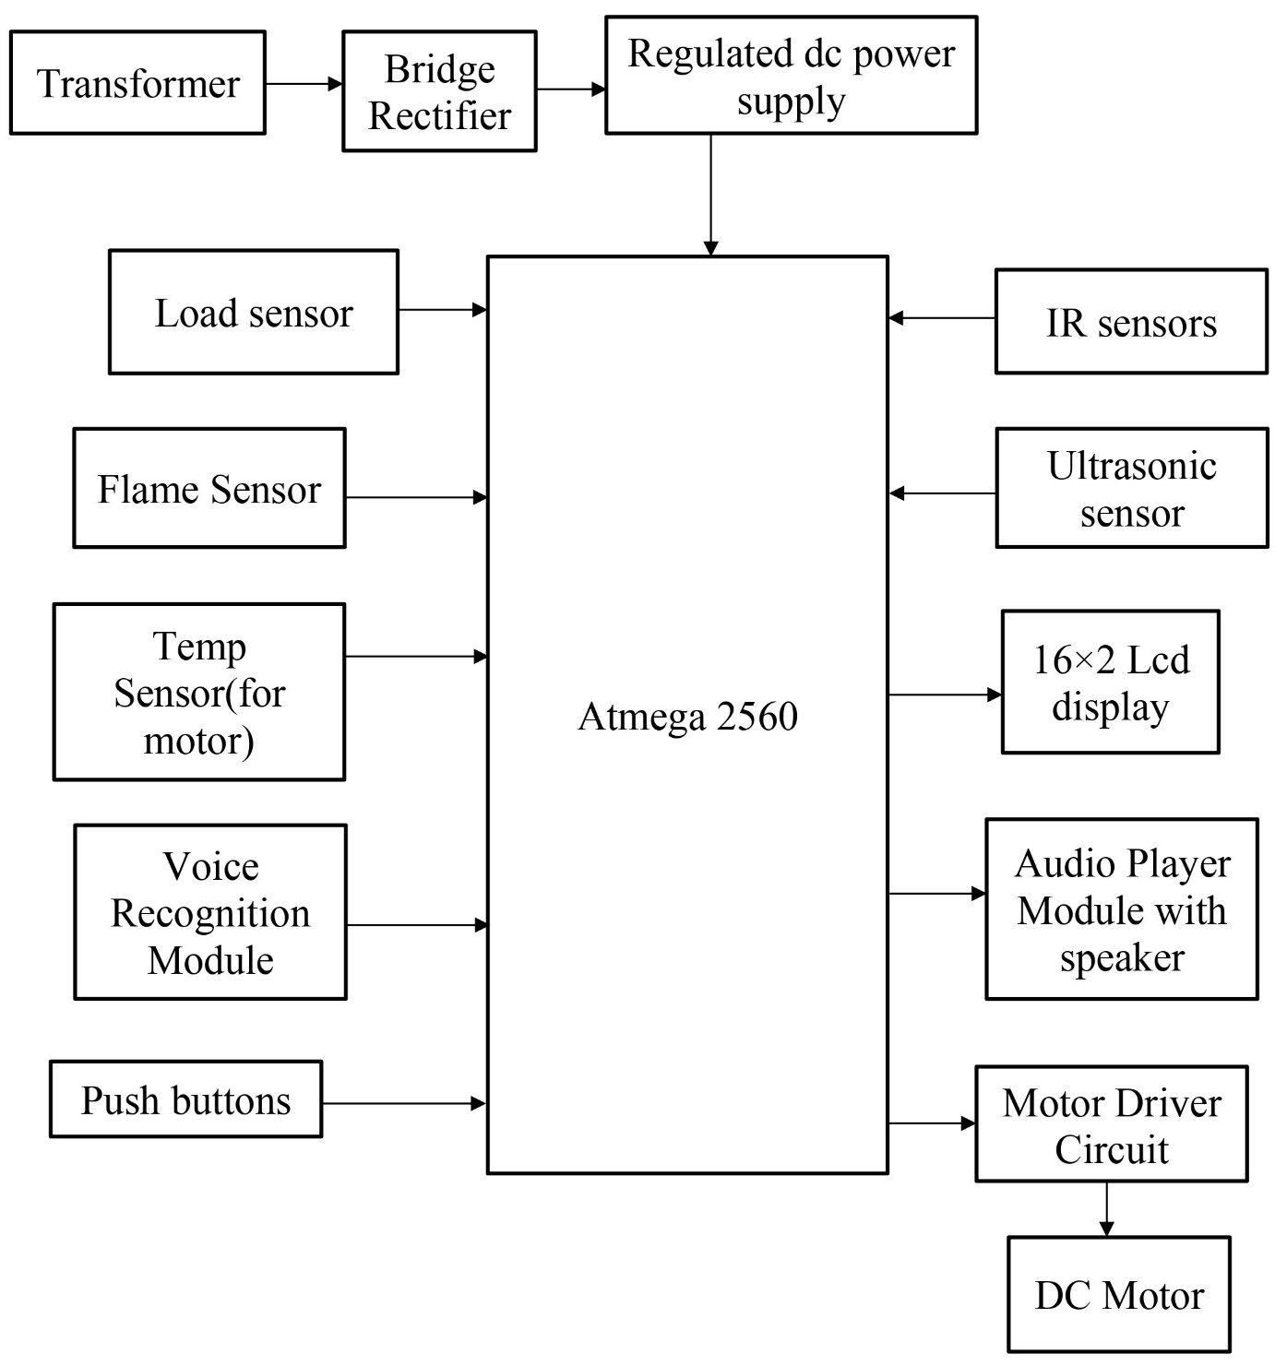
Block Diagram

Slide 12
Block diagram description
.Here the rectifier is used as a component of power supply. The 230V AC is step down to 12V AC using transformer and is rectified to 12V DC by the rectifier. LM7805 is used as the voltage regulator, which regulates the voltage to 5V [6].
The IR sensor is used in the lobby in front of lift doors to recognize whether anyone is near the door of lift. If yes then lift automatically goes on that floor, this feature is very useful for visually and physically disabled people who otherwise will have found it difficult to press the lift button in the lobby.
The voice recognition system is the main part of this project. Voice recognition module is communication mechanism between the user and microcontroller. The project will make the use of DC motor for the moving of lift. Microcontroller is programmed, with the help of C++ programming.

Slide 13
The microcontroller processes the received voice commands using a voice recognition module. Based on the recognized voice commands, the microcontroller's control logic will determine the appropriate actions to control the elevator, interfacing with the elevator's control circuitry and motor drivers to execute the commands accurately [7].
Load sensors placed within the elevator continuously monitor the weight of the carriage and passengers, ensuring that the elevator does not exceed its maximum weight capacity for safe operation. Also the temperature sensor monitors temperature of motor and flame sensor finds if there is any fire in lift.
Overall, this voice-controlled elevator system provides an innovative, user-friendly, and safe elevator experience for passengers.

Slide 14
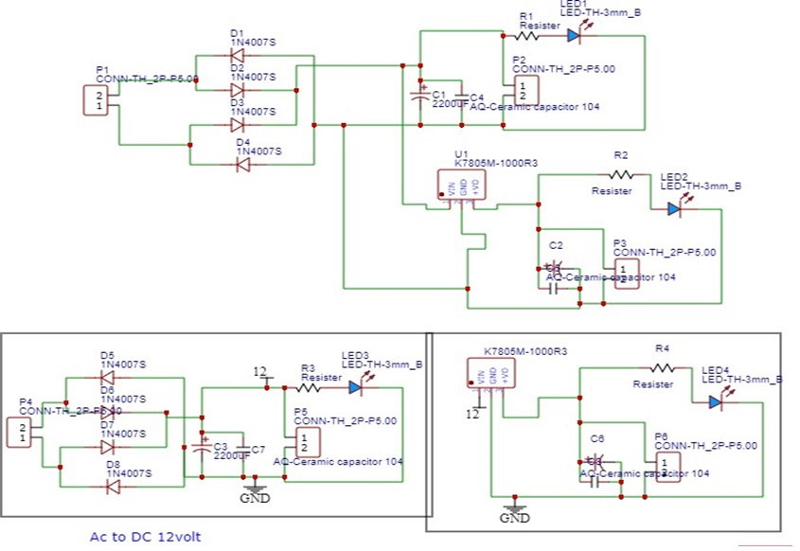
Circuit Diagrams
Power Supply

Slide 15
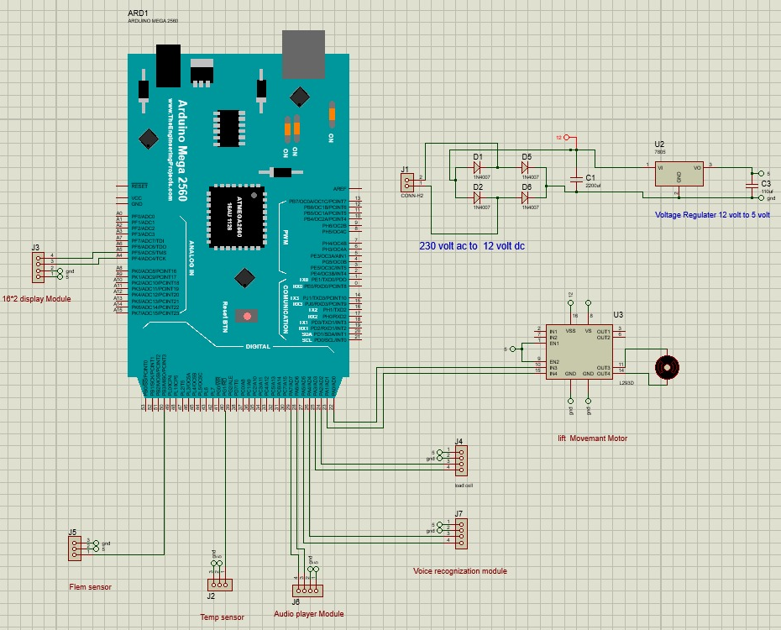

Slide 16
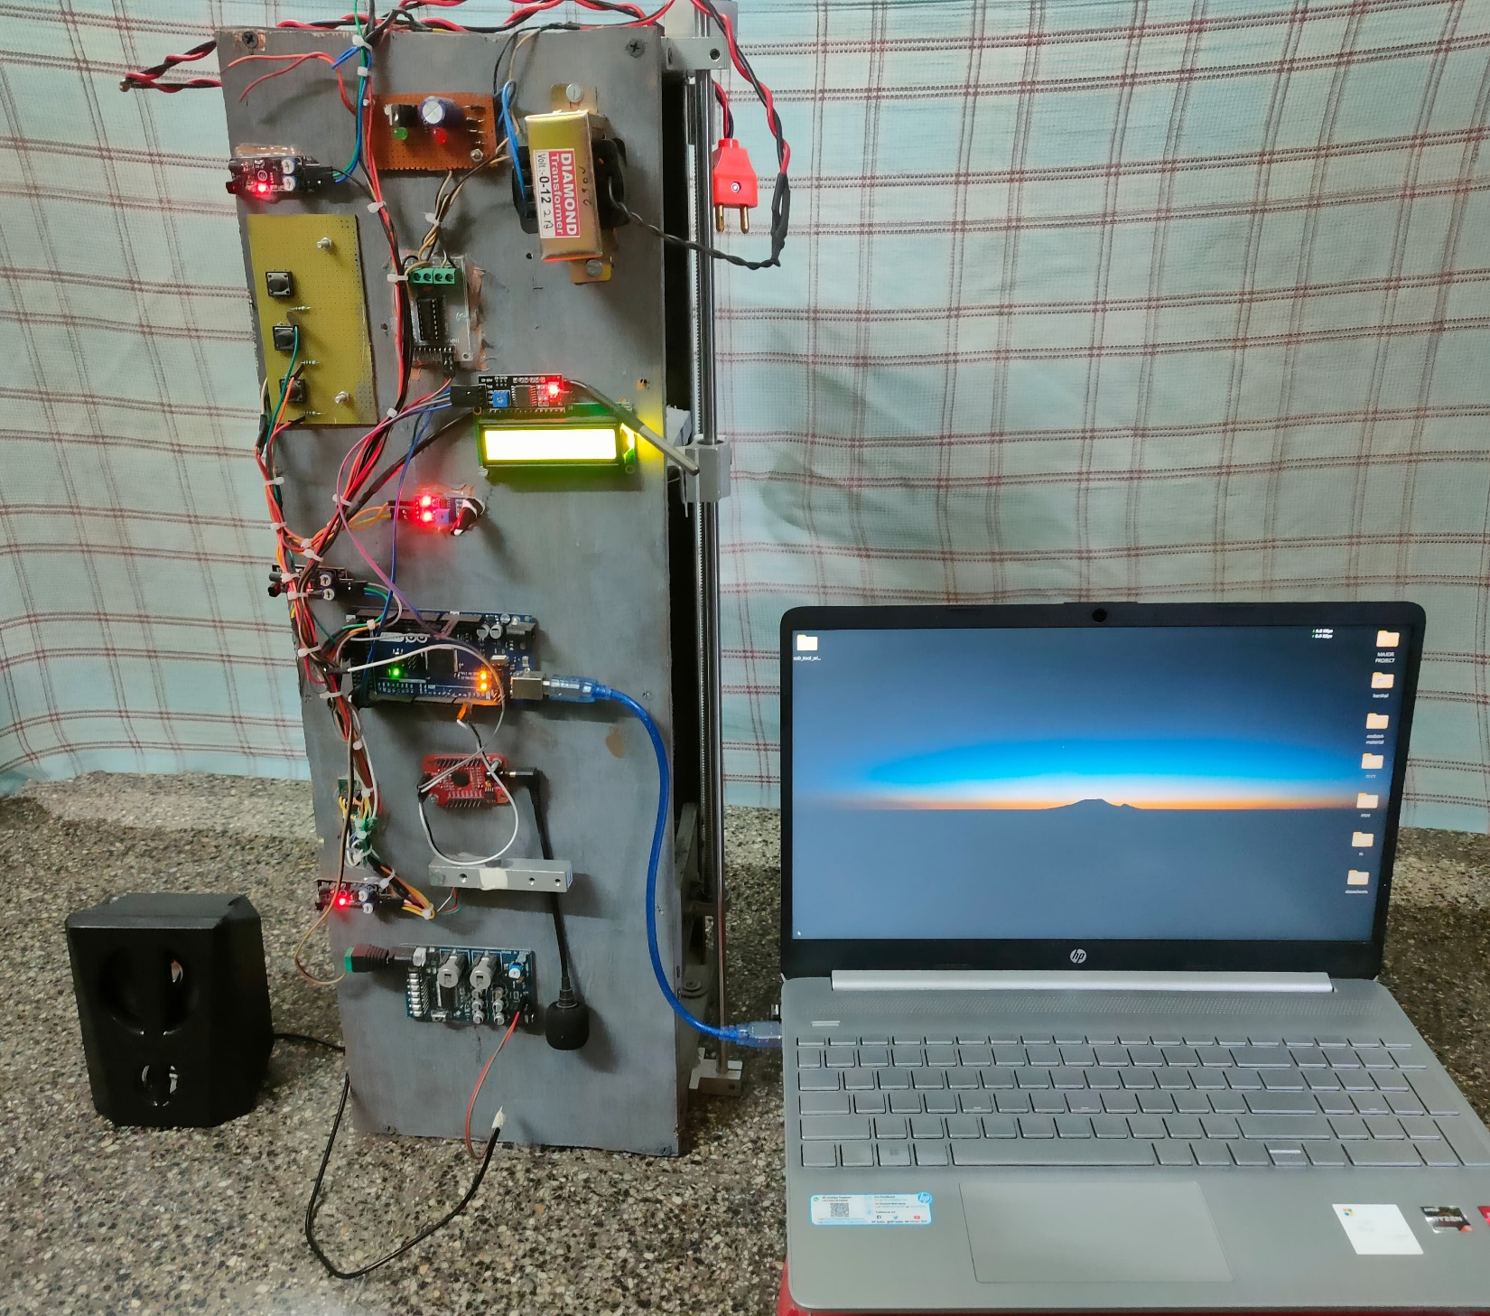
Prototype Image

Slide 17
Hardware and Software Requirements
H/W requirements:
Atmega 2560 microcontroller
Transformer
Bridge rectifier with dc supply
Load cell with hx711 sensor
Flame Sensor (YL 38)
Temp sensor (ds18b20)
Voice recognition module(V3)
Push buttons
IR sensors (IR-08H)
Ultrasonic sensor (HC-SR04)
16×2 Lcd display
I2C serial interface adapter module
Audio player module (APR33A3)
Speaker
Motor driver circuit (L293)
DC motor
S/W requirements:
Arduino IDE
PCB wizard

Slide 18
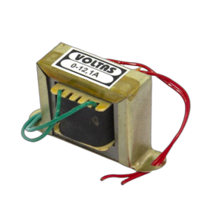
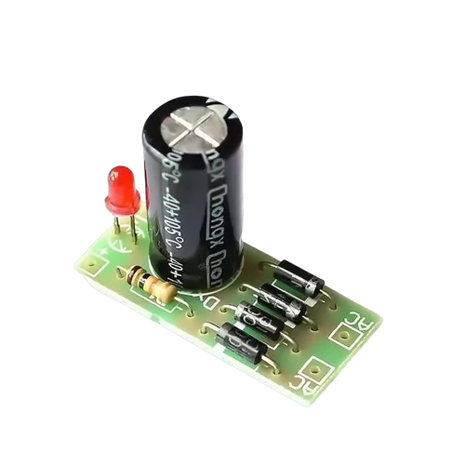
Description of Components
Transformer: Steps down the AC mains voltage to a suitable level for the rest of the system.
Specifications:
Input Voltage: 230 V AC
Output Voltage: 12 V AC
Output Current: 2 A
Mounting: Vertical mount type
Winding: Copper
Bridge rectifier with dc regulated supply: Converts the AC voltage from the transformer to DC. And removes pulsating DC by using a electrolytic capacitor.
Specifications:
Input Voltage: 12 V AC
Output Voltage: 12 V DC
Output Current: 2 A

Slide 19
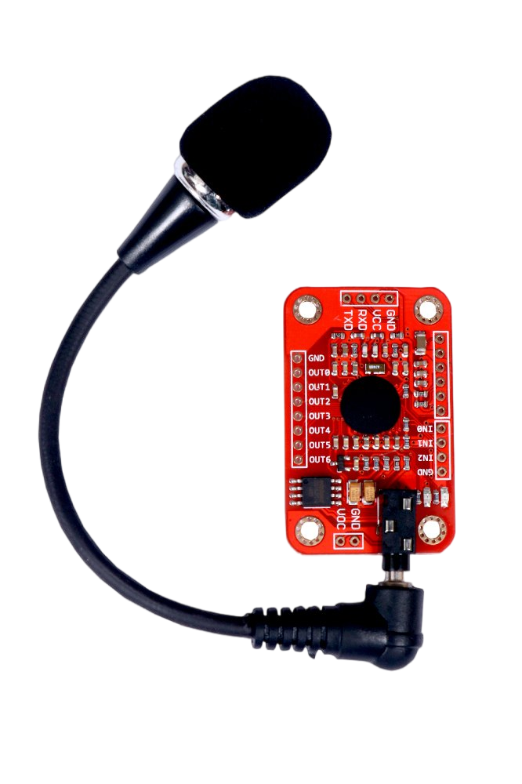
Voice recognition module(V3):
Converts the user's spoken commands into an command number which is already stored in module. Voice Recognition Module product is a speaker-dependent voice recognition module.
Users need to train the module first before let it recognizing any voice command.
Specifications:
Support a maximum of 80 voice commands, with each voice 1500ms (one or two words speaking).
Maximum 7 voice commands effectively at the same time.
User-control General Pin Output.
Analog Interface: 3.5 mm mono-channel microphone connector + microphone pin interface.
Input supply voltage: 4.5 - 5.5 V DC
Current: 40 mA
Recognition accuracy: 99%
Protocol: UART/GPIO

Slide 20
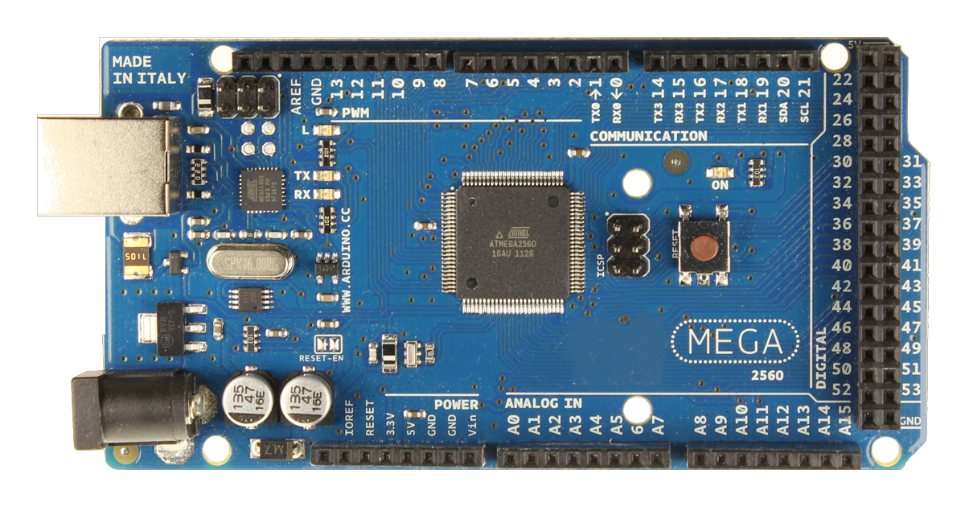
Atmega 2560 microcontroller[10]:
The brain of the system, which controls all of the other components. The ATmega2560 is an 8-bit, low-power microcontroller that is based on the AVR-RISC architecture. It's commonly found in the Arduino Mega 2560 development board.
Specifications:
Input supply voltage: 7 - 12 V DC
54 digital input/output pins (of which 15 can be used as PWM outputs)
16 analog input pins
4 hardware serial ports
16 MHz crystal oscillator
USB connection
Power jack
Reset button
8 KB of SRAM
4 KB of EEPROM
256 KB of flash memory (of which 8 KB
is used for the bootloader)

Slide 21
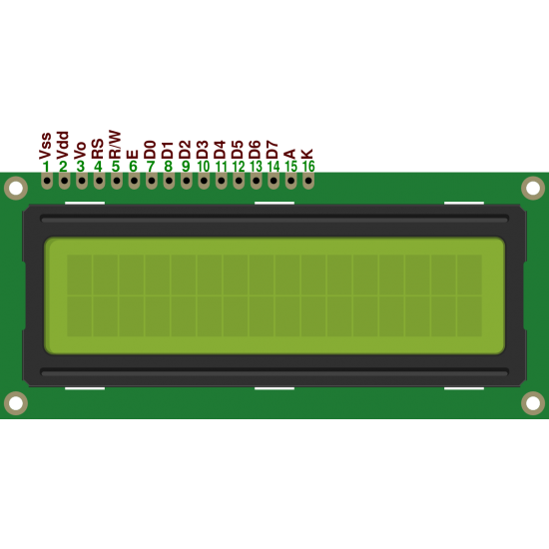
16x2 LCD display:
Displays the current floor number and other system information. A 16x2 LCD display can display 16 characters on 2 lines. The characters are white on a blue background. The display has a 5x7 pixel matrix for each character.
Specifications:
Display capacity: 16 characters x 2 rows
Display color: Blue backlit
Character size: 2.95 mm wide x 4.35 mm high
Current requirements: 2 mA @ 5 V DC
Voltage requirements: 5 VDC +/- 0.5V
Character pixels: 5 W x 7 H
Total pins: 16
Data pins: 8 (D0 to D7)

Slide 22
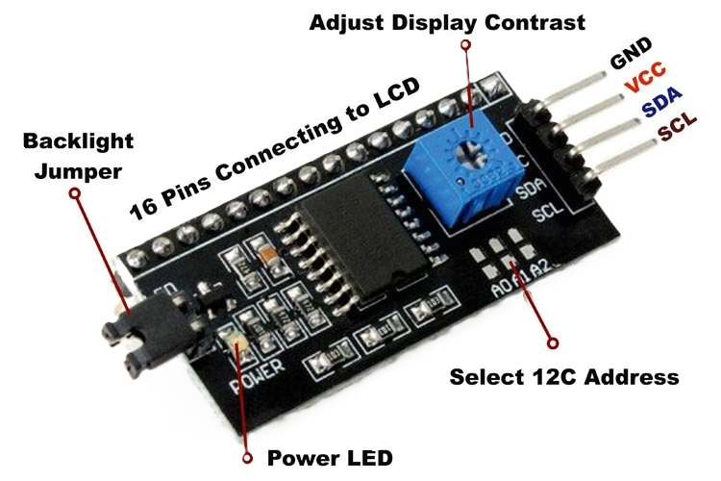
I2C serial interface adapter module:
This LCD I2C adapter module is designed to fit directly below the standard 16x2 LCD display. Then through this module, the LCD can communicate through I2C protocol which requires only 2 pins from the controller side and then uses the PCF8574 IC to receive data from I2C and display them on the LCD screen.
Specifications:
Power Supply: 5 V DC
Can have 8 modules on a single I2C bus (change address via solder jumpers)
Backlight of the LCD display can be enabled or disabled via a jumper on the board
Serial I2C control of LCD display using PCF8574
Contrast of the LCD screen control via a potentiometer

Slide 23
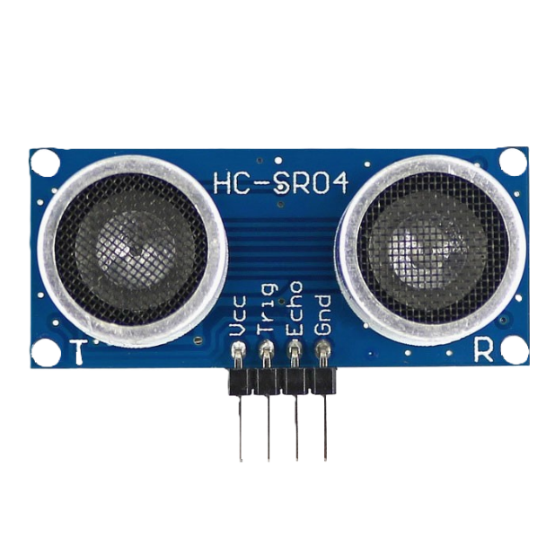
Ultrasonic Sensor(HC-SR04):
This HC-SR04-Ultrasonic Range Finder is a very popular sensor that is found in many applications where it requires measuring distance and detecting objects.
The module has two eyes like projects in the front which forms the Ultrasonic transmitter and Receiver.
It offers excellent range accuracy and stable readings in an easy-to-use package. Its operation is not affected by sunlight or black material.
Specifications:
Power Supply: 5 V DC
Working Current: 15 mA
Working Frequency: 40 kHz
Ranging Distance : 2 cm – 400 cm
Resolution : 0.3 cm
Measuring Angle: 15°
Trigger Input Pulse width: 10 µS

Slide 24
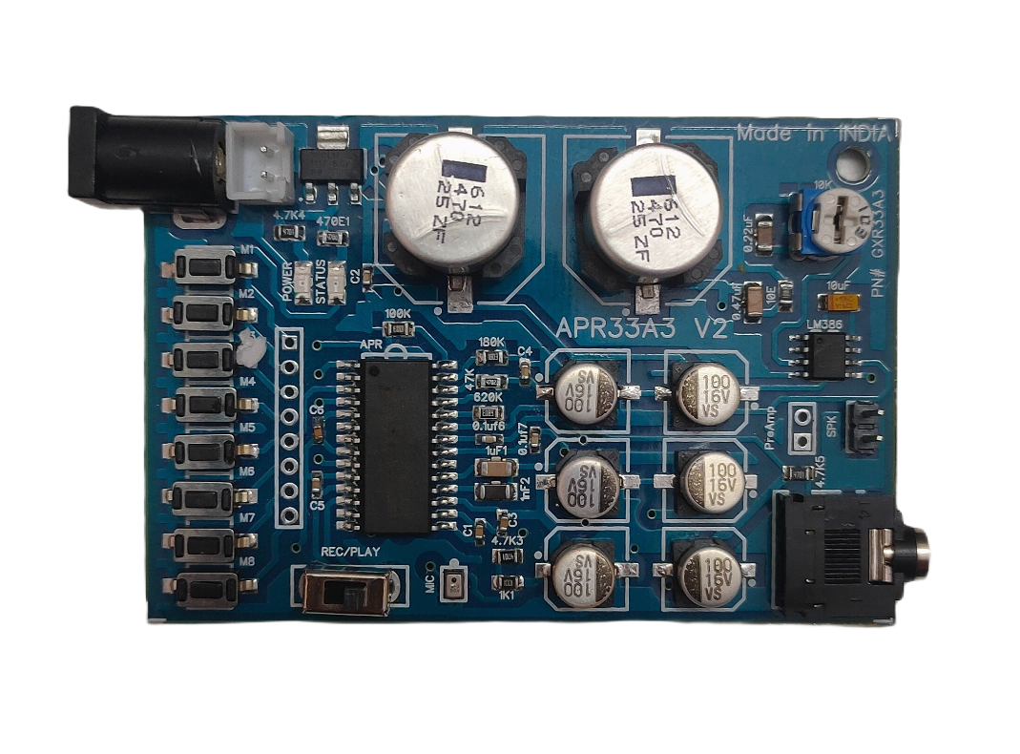
Audio player module(APR33A3):
The APR33A3 Voice Recorder and Playback Module is an incredible device that allows users to particularly record and playback audio files with ease. It features a built-in microphone, support for multiple audio formats, and significantly a 3.5mm headphone jack. It’s a great choice in any case for anyone looking to quickly and easily capture voice recordings and playback them back with clear audio quality.
Specifications:
Working voltage: 5 V DC
Current: 500 mA
Number of Channels: 8 Channel
Recording time on all the 8 Channels: 10 min
Mic: On Board
Speaker: 1/2 W Speaker
Playback and Recording Switch
Status Indicator
On Board Gain controller.
Microcontroller TTL Interface Pins with respect to Ground (not soldered on Board).
On board AUX Jack for the easy interface of the Mobile Phone and Laptop.
Output: Amplified Speaker Output through LM386 Audio Amplifier

Slide 25
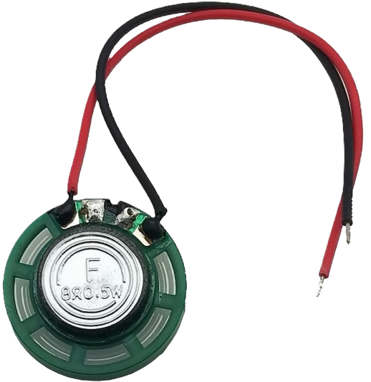
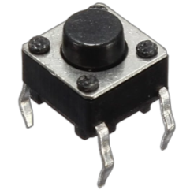
Speaker:
This speaker cone is mostly used for low power circuits. It is used in this project for playing audio cues related to lift.
Specifications:
Rated power: 0.5 W
Rated impedance: 8 Ω
Frequency response: 45 kHz
Noise ratio: 92 ± 3 (dB)
Diameter: 36 mm
Push button:
They are used to manually use the elevator. This push buttons can be used as floor number burtons, lift arriving button, etc.
Specifications:
Voltage rating: 24 V DC
Current rating: 50 mA
Insulation resistance: 100 MΩ
Operating force: 2.55±0.69 N
Contact resistance: 100 mΩ
Operating temperature range: -20 to +70 °C

Slide 26
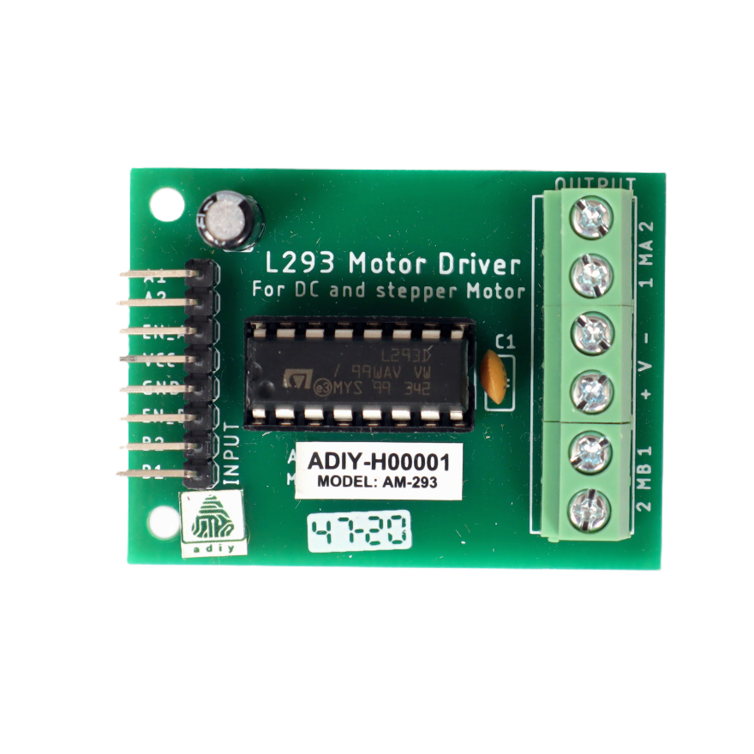
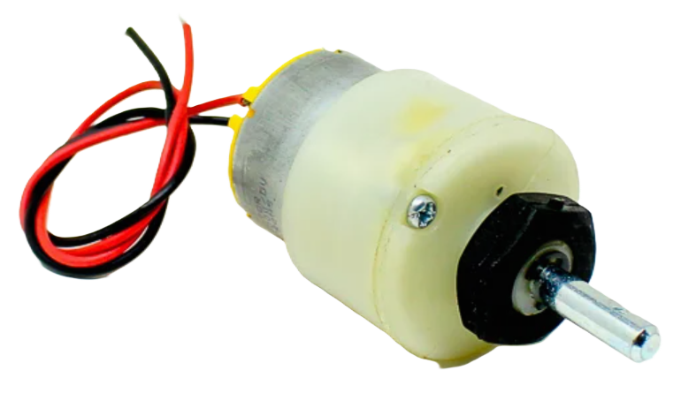
Motor Driver circuit(L293):
L293D Motor Driver Module is a medium power motor driver perfect for driving DC Motors and Stepper Motors. It uses the popular L293 motor driver IC. It can drive 4 DC motors on and off, or drive 2 DC motors with directional and speed control.
Specifications:
supply voltage: 4.5 V to 12 V
Motor voltage output VCC: 4.5V to 36V
Maximum Peak motor current: 1.2 A
Transition time: 300 ns
DC motor:
These motor is simple DC Motor featuring gears for the shaft for obtaining the optimal performance characteristics. They are known as Center Shaft DC Geared Motors because their shaft extends through the center of their gearbox assembly. We are using it for moving lift up-down.
Specifications:
Rated Speed: 200 RPM
Operating Voltage: 12 V DC
Load Current Max: 300 mA
No-Load Current: 60 mA
Rated Torque: 1.5 kg-cm
Stall Torque: 5.4 kg-cm

Slide 27
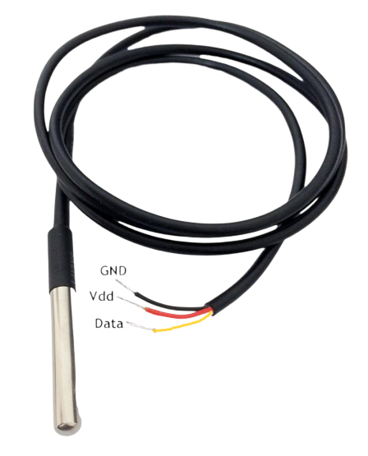
Temperature sensor (ds18b20):
The DS18B20 is a programmable digital temperature sensor that communicates using the 1-Wire method. It doesn't require any external components to operate. We have used it to measure the temperature of DC motor to avoid overheating of motor.
Specifications:
Temperature range: -55°C to +125°C
Accuracy: ±0.5°C
Output resolution: 9-bit to 12-bit (programmable)
Operating voltage: 3V to 5V
Current Consumption: 1 mA
Conversion time: 750ms at 12-bit
Standby current: Typically 3µA at +125°C
Unique 64 bit ID burned into chip.

Slide 28
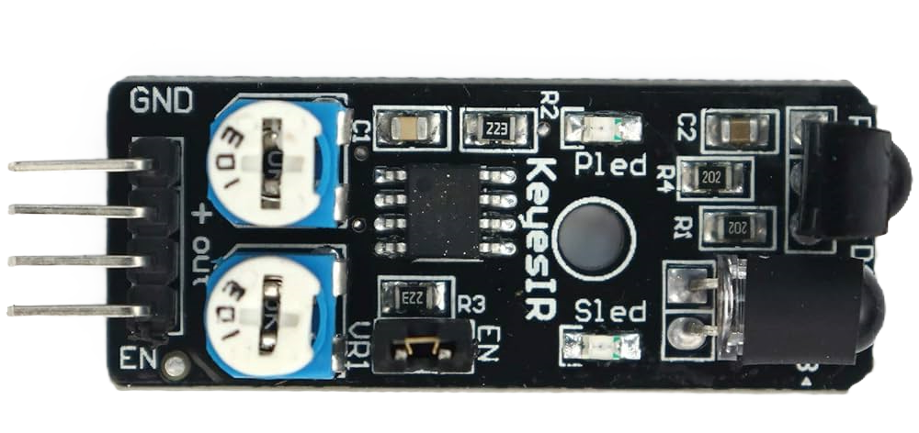
IR sensor(IR-08H):
Infrared IR Sensor Module (Active Low) has a pair of infrared transmitting and receiving tubes. When the transmitted light waves are reflected back, the reflected IR waves will be received by the receiver tube. The onboard comparator circuitry does the processing and the green indicator LED comes to life.
The module features a 4 wire interface with VCC, GND, EN and an OUTPUT pin on its tail. It works fine with 3.3 to 5V levels. Upon hindrance/reflectance, the output pin gives out a digital signal (a low-level signal)
We are using it in lobby of each floor to detect human presence in front of lift door at that particular floor.
Specifications:
Operating Voltage: 3.6 - 5 V DC
Supply current: 20 mA
Detection Angle: 35°
Distance Measuring Range: 2 – 30 cm
I/O pins are 5V and 3.3V compliant
Built-in Ambient Light Sensor
Adjustable Range
Adjustable Frequency
LED Indicators

Slide 29
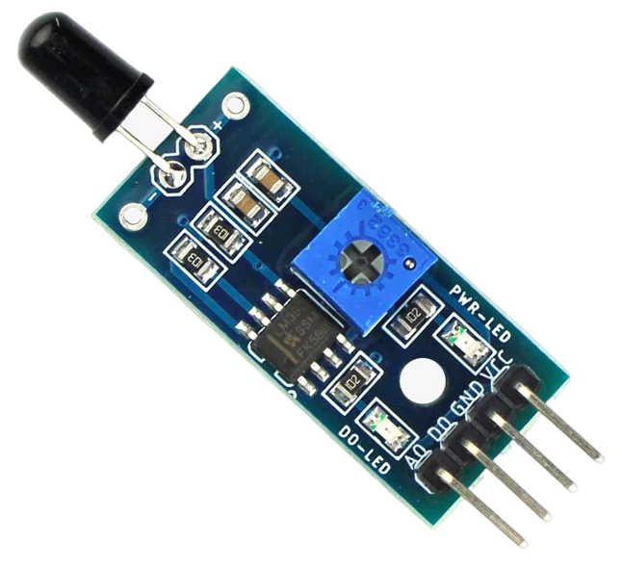
Flame sensor(YL 38):
This tiny Flame sensor infrared receiver module can use to detect flame or wavelength of the light source within 760nm~1100nm also useful for Lighter flame detect at the distance 80cm. We are going to use it to detect fire inside the lift.
Specifications:
Operating voltage 3.3V - 5V
Wavelength: 760 nm - 1100 nm
Detection range: up to 100 cm
Detection angle: 60°
Comparator chip LM393 makes module readings stable.
Fast Response Time
Sensitivity adjustable
Adjustable detection range.

Slide 30
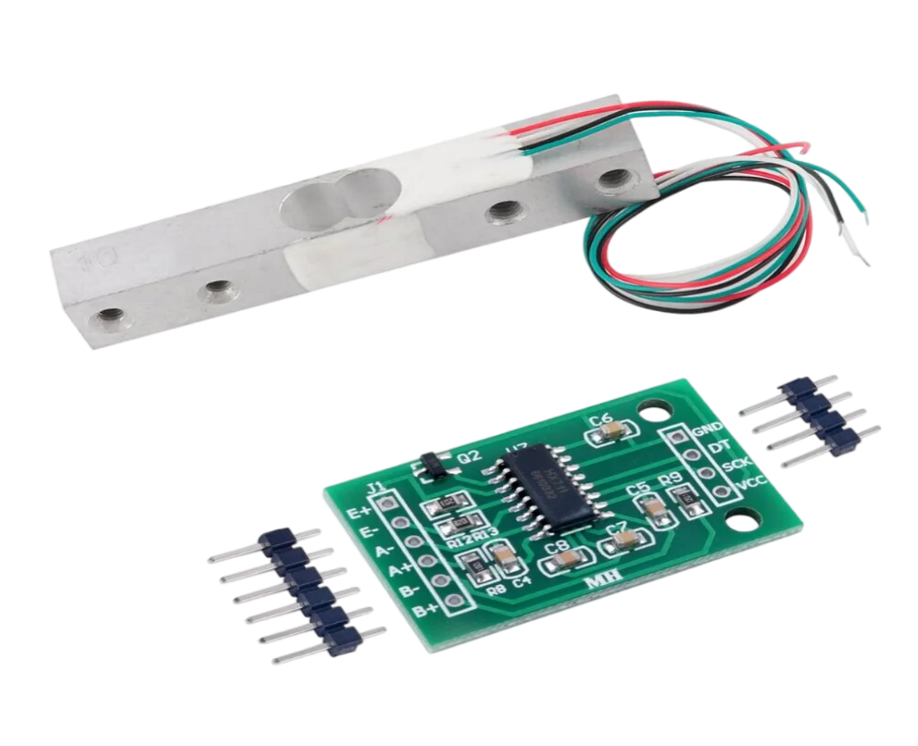
Load cell with hx711 sensor:
This weighing Load Cell Sensor (sometimes called a strain gauge) can translate up to 1 kg of pressure (force) into an electrical signal. Each load cell is able to measure the electrical resistance that changes in response to, and proportional of, the strain (e.g. pressure or force) applied to the bar.
The HX711 Dual-Channel 24 Bit Precision A/D weight Pressure Sensor is a Load Cell Amplifier breakout board, for the HX711 IC that allows us to easily read load cells to measure weight. We will be able to read the changes in the resistance of the load cell, and with some calibration. We are using it to measure whether lift has overweight or not.
Specifications:
Operating voltage: 5 - 10 VDC
Operating current: 10 mA
Differential input voltage: ± 40 mV
Data accuracy: 24 bit
Refresh frequency: 10/80 Hz
Operating Temperature: -40 to +85 °C

Slide 31
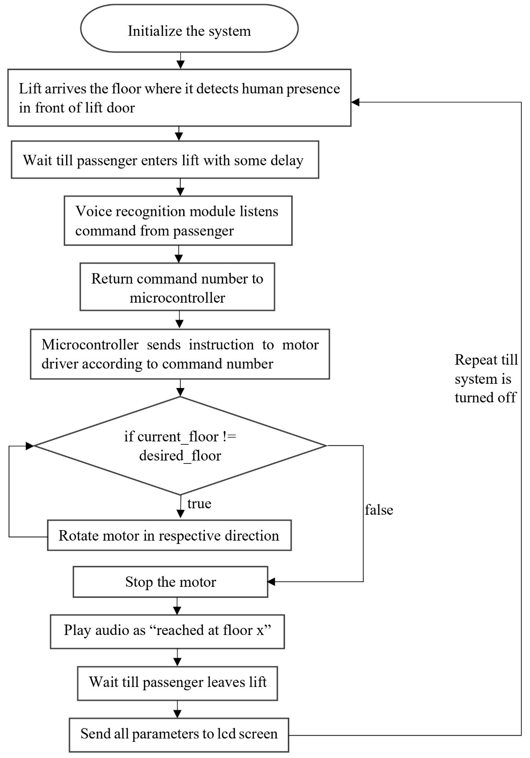
Flow chart

Slide 32
Detailed Algorithm
Initialize the system.
Lift arrives the floor where it detects human presence in front of lift door.
User enters into lift.
Listen for a voice command from the user.
Compare the voice command with already stored commands and return command number using the voice recognition module.
Microcontroller determines which floor the user wants to go to based on the command value returned by voice recognition module.
Send a signal to the relay driver circuit to activate the DC motor in the desired direction.
Monitor the current floor number using the Ultrasonic sensor.
When the lift car reaches the desired floor, send a signal to the relay driver circuit to deactivate the DC motor.
Play an audio cue to inform the user that they have arrived at their destination.
While all this is working, the floor number, motor temperature, flame sensor, and load sensor parameters are send to lcd screen for monitoring purpose.
Repeat steps 2-12 until the system is shut down.

Slide 33
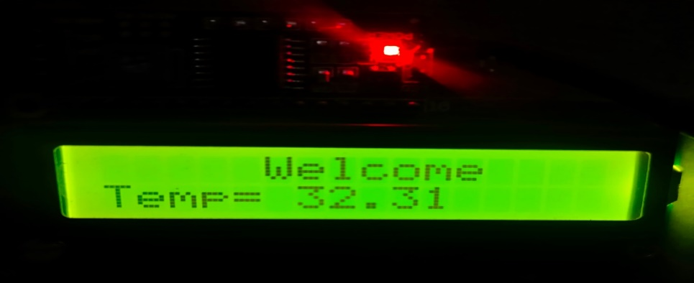
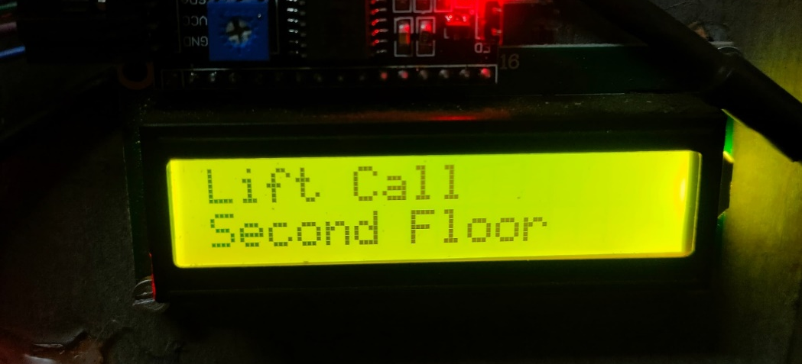
Results
Welcome screen:
This screen is seen during system initialization. It shows welcome message and temperature of lift motor. It is display on 16×2 LCD display with green backlight.
Floor description screen:
This screen is seen when we call a certain floor. It is seen before and after the lift load check screen. It is useful for visual confirmation of called lift floor.

Slide 34
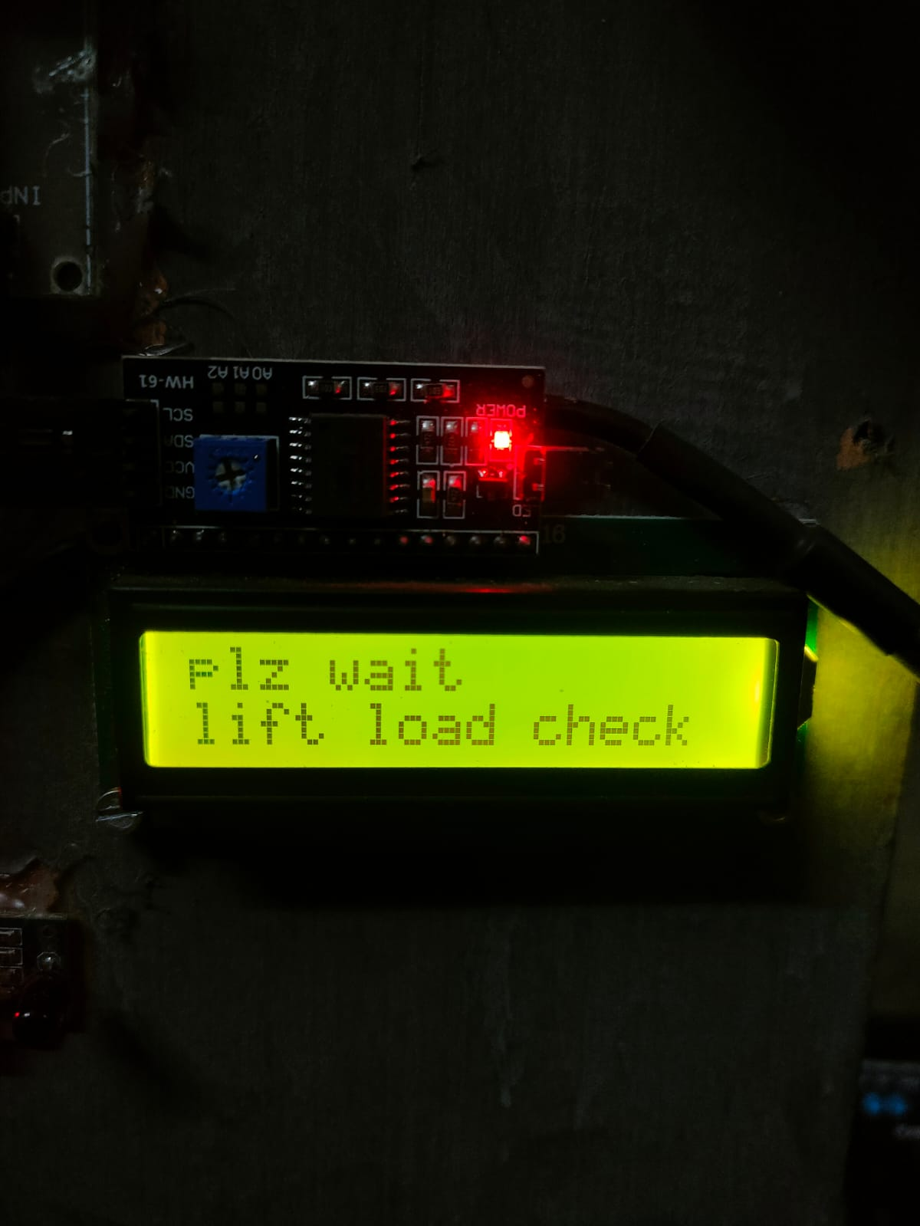
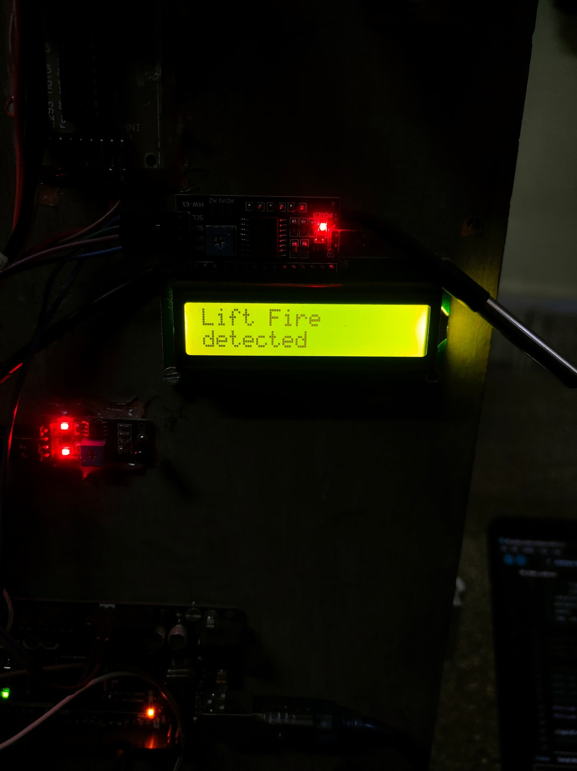
Load check screen:
This screen appear after floor description screen. It checks weight until microcontroller counts 500 increments. After that it either motor starts rotating or it shows lift overload.
Fire detection screen:
This screen appears when fire is detected near flame sensor. Due to fire, lift stop function triggers which stops lift immediately.

Slide 35
Advantages
Enhanced Accessibility and Hygiene: Voice control simplifies operation, making the elevator user-friendly for all, while reducing germ transmission by eliminating the need for button presses.
Safety: The system includes safety features such as load sensors, IR sensors, flame sensors, temperature sensors, and ultrasonic sensors, which can help to prevent accidents.
Advanced Safety: Integrated sensors monitor critical parameters, ensuring immediate error handling and preventing accidents, guaranteeing a secure journey for passengers.
Clear Communication and Emergency Response: Auditory feedback provides floor updates, while voice-activated emergency features enable swift communication with building management or emergency services, enhancing safety and convenience.
Future-Proof Technology: The integration of voice control ensures adaptability to future advancements, prolonging the system's relevance and maximizing return on investment for building owners.

Slide 36
Limitations
Complexity: Implementing voice recognition and multiple sensors can add complexity to the system and can also be little bit hard to program such complex hardware.
Maintenance: Advanced features may require more maintenance and troubleshooting and annual audit to check the working of lift.
Cost: The additional components and technology can increase the overall cost of the system, especially voice recognition modules are costly as well as they require high end hardware
Voice recognition: Currently voice recognition is user dependent, so for user-independent voice recognition high end module is needed which increases system cost further.
User Adaptation: Users may need time to adapt to voice commands and auditory feedback.

Slide 37
Application
Hospitals: In hospitals, voice control can be helpful for patients and staff who may have difficulty using traditional buttons.
Hotels: Voice-operated lifts can be a luxurious and modern addition to hotels.
Residential buildings: Voice control can be a convenient option for people living in residential buildings, especially for those with disabilities.
Public buildings: Voice-operated lifts can be helpful in public buildings such as libraries and museums, where people may be carrying items or have difficulty using traditional buttons.

Slide 38
Conclusion
Voice-controlled elevators are a long-term solution that can be used by anyone, including people with disabilities. They have the potential to make life easier for everyone and reduce the spread of germs.
In addition to the benefits mentioned above, voice-controlled elevators could also be used to improve security and convenience. For example, authentication could be used to restrict access to certain floors, and sensors could be used to reduce the need for users to give specific commands.
Voice-controlled elevators have a wide range of potential applications, including in homes, offices, hospitals, hostels, and public places.
Overall, voice-controlled elevators are a promising technology with the potential to improve our lives in many ways.

Slide 39
Future Scope
Advanced safety features could analyse sensor data to predict potential problems before they occur, preventing breakdowns and ensuring a smooth ride.
In case of emergencies, a two-way voice communication system would connect you directly with a designated responder, providing immediate assistance.
The system could adapt to your preferences, offering calming music for a relaxing journey or informative announcements about upcoming events on your destination floor. Integration with smart devices would allow you to seamlessly call the lift using voice commands on your phone or wearable, further streamlining the process.
The lift could even integrate with wheelchairs or other mobility aids, automatically adjusting its height to ensure a safe and comfortable entry and exit. Additionally, clear audio descriptions would detail all lift features and controls, catering to users with various needs.
By focusing on these advancements, voice-operated lifts are poised to revolutionize how we travel within buildings. They won't just be a means of transportation, but an intelligent and user-friendly extension of the smart building experience.

Slide 40
References
Dilip Mathuria, Aditya Gaur, Ashish Gupta, “FPGA Implementation of Biometric based Elevator Controller”, IJETSR Volume 5, Issue 3, March 2018
Farouk Salah Mohamed Saod, Dr Maher Abdel Aziz, “Elevator for blind people using voice recognition” International Journal of Scientific & Engineering Research vol 9 Issue 7,July 18
Kaladharan N, Assistant Professor ,Dept. of Electrical Engineering. Annamalai University, IJIRCCE, “A study of speech recognition” volume.3,issue 9,page 8030- 8034,September 2015.
Komal Mahajan, Riddhi Nahar, Dhanali Khairnar, Shrutika Kinge, Sujata Suryawanshi, “Elevator Control Using Speech Recognition for People with Physical Disabilities” IJARIIE Vol-7 Issue-3 2021
Rashmi P C, Amulya, A Karthik Shetty, “Voice Operated Intelligent Lift” JETIR February 2019, Volume 6, Issue 2
Malim Huzaifa Salim, Sami Jaitapkar, Faki Ziyaan, Kazi Ibrahim, “Voice Based Lift Control” IJRASET Volume 10 Issue V May 2022

Slide 41
P.Cernys, V.Kubilius, V.Macerauskas, K.Ratkevicius, “Intelligent Control of the Lift Model” IEEE international Workshop on Intelligent Data Acquisition and Advanced Computing System: Technology and Applications 8-10 September 2003
Aishwarya Pokharkar, Niriksha Poojari, Harish Pawar , Amey Patil, “Voice Operated Elevator” IJISRT Volume 6, Issue 5, May – 2021
B. Swathi, Akshay S Prathap, Aiswarya V Kumar, Ranjitha R, Raviteja Kaki, “Implementation of Voice based Touchless Lift System” IJSRCSEIT Volume 7, Issue 4, July-August-2021
Datasheet of Atmega 2560 microcontroller [https://ww1.microchip.com/downloads/en/devicedoc/atmel-2549-8-bit-avr-microcontroller-atmega640-1280-1281-2560-2561_datasheet.pdf]

Slide 42
Thank You !!!

